Slide 1

E Safety
Mr Butler

Slide 2
What is E-safety?
E-safety is often defined as the safe and responsible use of technology.
  This includes the use of the internet and also other means of communication using electronic media (eg text messages, gaming devices, email etc).
In practice, e-safety is as much about behaviour as it is electronic security.

Slide 3

Class Discussion: Is Our Data Private?
What information about you could be being shared online?
What information would you not like to appear online?
How can you keep information private in the “digital world”?

Slide 4
Which of the following are examples of Personal Information?
        Home Address
        Phone Number Email
        Hair Colour Status Update
        Photos
        Age
        Bank Account Number
        Number of Friends
        Date of Birth School
        Stand up If you think at least 5 of these are personal information that should be kept private?

Slide 5
Which of the following are examples of Personal Information?
KEEP IT PRIVATE
        Home Address
        Phone Number Email
        Hair Colour Status Update
        Photos
        Age
        Bank Account Number
        Number of Friends
        Date of Birth School
        Stand up If you think at least 5 of these are personal information that should be kept private?

Slide 6
Becky’s Video
Click here to Watch the Video (Resource 1 – Becky, or next slide)
How can you stay safe online?
What can you do to stay in control of your online profile?
Who should you tell if you are worried?

Slide 7


Slide 8
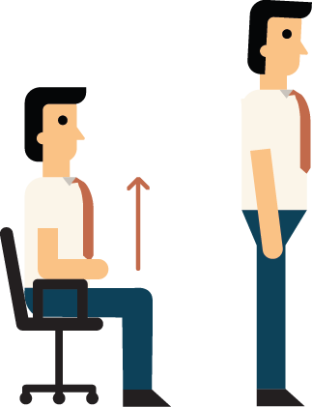
Stand Up, Sit Down!
Stand up if you agree / think the statement is true
Stay seated if you disagree/ think the statement is false.

Slide 9
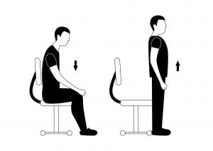
It is OK to post a photo of yourself in your school uniform on social networking sites.
If you put a photo onto the internet, it’s there FOREVER. Remember you can’t delete it or take it back.
NEVER send photos to people you do not know.
NEVER post pictures you wouldn’t want your parents/teacher/grandparent to see.
Don’t use your own photo as a profile picture. Use a cool graphic instead – this is known as an Avatar.
TRUE
FALSE

Slide 10
It is OK to accept friends online even if you don’t know them in person.
Be very careful who you accept as friends – they gain more access about you, your other friends and personal details about you when you add them.
The average person has 55 ‘real life friends’ and over 200 ‘online friends’.
Don’t just add ‘Friends of friends’ – you have no idea who they actually are.
Adults with bad intentions can pretend to be young people on these sites and try to make contact with children.
TRUE
FALSE

Slide 11
It is OK to post when I go on holiday.
Think about what you have just told people about your home – it’s now vacant. Wouldn’t be nice to come home to find out your house has been burgled?
TRUE
FALSE

Slide 12
Is it ok to Update my Status with personal information about myself such as my phone number
The information on your status could potentially be viewed by anyone such as “friends of friends of friends”
You would not give your information to a stranger so why share it online?
You don’t know what they’ll do with your personal information.
TRUE
FALSE

Slide 13
Is it a good idea to keep my Profile Private so only close friends and family can see it.
By setting the Privacy settings on your online profile you can restrict who can see your posts and status updates
This gives you more control so only your “real friends” can see what you post.
You can block contact requests also and/or give people access to your profile who you actually know in real life.
TRUE
FALSE

Slide 14
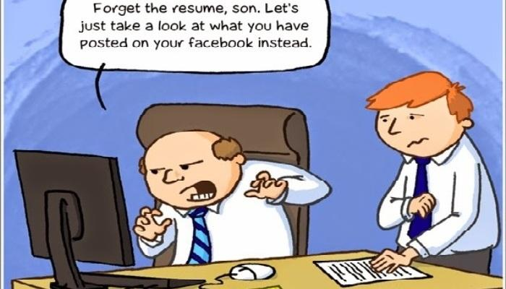
Remember;
You can post a funny or embarrassing photo about someone. But what happens when someone uses that photo to make you feel uncomfortable?
NEVER post photos or images that you wouldn’t want your nanny or teacher to see!
Employers often use the internet to look up your profiles on social media. If they see these photos about being silly – even at a young age – that could affect your employment even if you didn’t post it yourself!

Slide 15

Someone making you feel uncomfortable online?
DO NOT ‘just delete them’. The messages may be used as evidence if it goes to court.
DO NOT reply to the messages.
TELL SOMEONE you trust – parents, guardians, teachers, police etc.
Click CEOP or Childline.

Slide 16

Activity: Safety First!
It is extremely important that you are aware of being safe online.
Research CEOP and how Childline can help people like Becky. It could be you, so it is very important that you stay safe online.
Create a poster to tell people what they should do if they feel uncomfortable when online.
On the next slide, I will show you what you need to include in your poster.

Slide 17
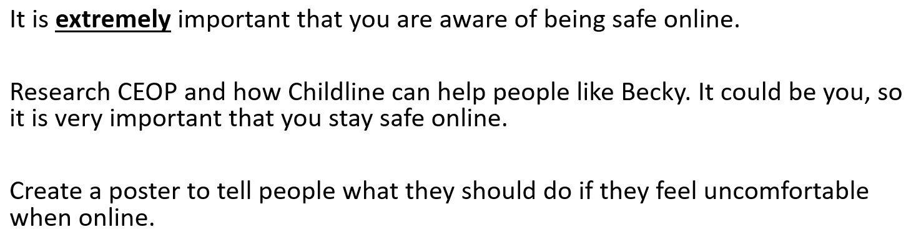
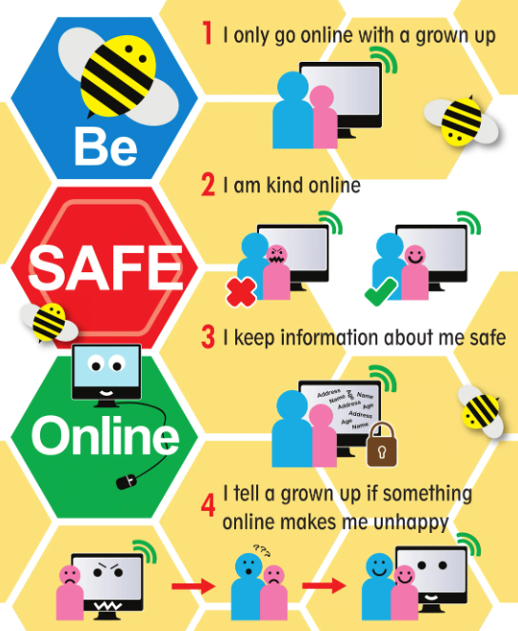
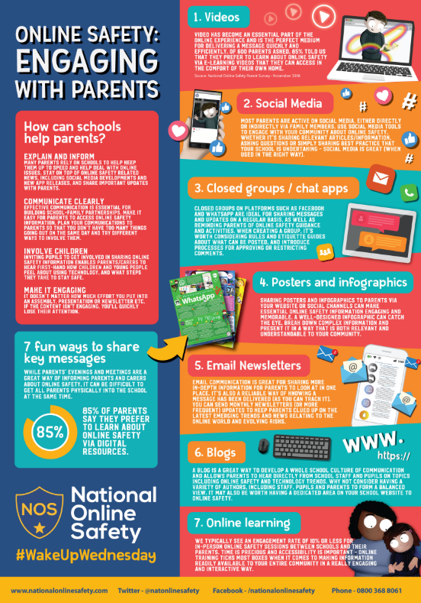
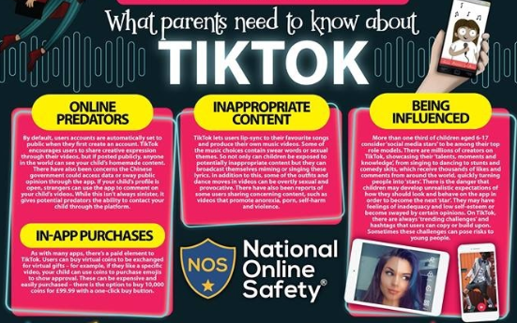
E Safety Poster
You need to include:
Colour (3 to 5 colours is plenty!)
A Design
Key Terms & definitions
What CEOP are
Add your Name and class!
Keep your text readable and clear
    Write in full sentences.
    Use one (max two) font(s)
Add images
    Keep similar styles
      (i.e. try to avoid clipart and then a real life photograph and then a drawing)
Examples:

Slide 18
Evaluations
We now need to evaluate our work.
It is important to view our work in both a critical and positive approach. That way, we can see where we can develop further.
For example, if you liked the colour scheme but next time I need to work on the textboxes having a black border around all of them, or just using speech bubbles instead of actually designing a textbox shape instead.

Slide 19

Mr Butler | Online Safety

Slide 20

Starter: Think Pair Share
Why is your privacy important?
Have you ever been in a situation when something private, or secret, of yours got out?

Slide 21





Live streaming report reveals nearly a 1/3 of 11-13 year olds are broadcasting themselves live on the internet
47% of young people think it’s important to ‘fit in’ online
81% of 8-17 year olds say they know when and how to ask permission to post something about someone else
52% say someone they know shared a photo or video of them without asking them first.

Slide 22
As you make the transition to a more independent stage with the move to secondary education, you will become more confident internet users with more varied habits.
Internet use can be hugely positive but there are also potential dangers if we use the internet incorrectly. It is vital to continue discussing online safety to ensure that we become good “online citizens”.

Slide 23
What are examples of Personal Information?
KEEP IT PRIVATE.
Are any of the following things personal information?
Phone Number
Email
Home Address
Number of Friends
Hair Colour
Status Update
Photos
Age
Number of siblings
Full Name
What should you do with your Personal Information?
That includes sharing this information online.

Slide 24




Your Online Activity
You may already be using the internet to carry out the following things:
Online Gaming
Downloading Content
Social Networking
App Purchases

Slide 25
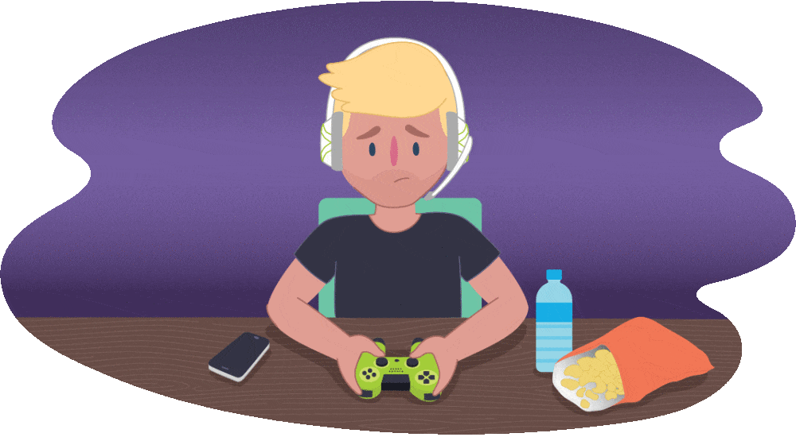
Online Gaming
Online Gaming means that you can play in real time with people across the world through an electronic device.
_______________________________________
What you need to know about Online Gaming
_______________________________________
Some games let people chat to anyone in the world. This means you may come across offensive language and bullying.
Not everyone online is who they say they are. You should avoid giving out personal details that could identify you or your location.
Some games encourage players to buy extra elements during the game – it has been known to run up large bills without realising.
In extreme cases bullying, also known as ‘griefing’, can be used as a tactic to win games. Children may find themselves either bullying or being bullied.

Slide 26


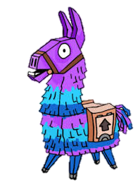

Keeping yourself safe while Online Gaming
Tell your parents who you play with online and who you meet and talk to.
It is important that your use of language is being used appropriately in live chat (usually via headphones). Gaming sites often have ways of reporting abusive chat and excluding anti-social players. Make sure you familiarise yourself with how to do this.
Change the settings on your tablet or smartphone to ‘airplane’ mode. That way, you can play the game offline without making accidental purchases or connecting with someone you don’t know.
Do not share personal information and keep gaming friends in the game only rather than adding them to their other social networks.
91% Of Children are Gamers
68.8% of Fortnite Players have spent money on in-game purchases
The average Fortnite player
Spends 6-10 hours a week playing the game

Slide 27
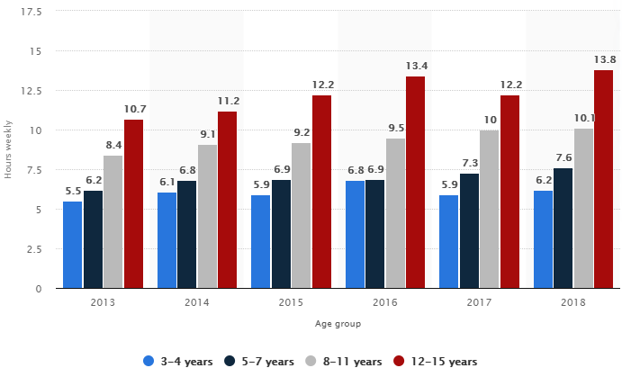
Hours children spent gaming weekly in the United Kingdom (UK) from 2013 to 2018, by age group

Slide 28

Downloading Content
The internet gives the opportunity to download content such as video, music and other similar files. Downloading can also expose you to viruses and spyware.
The ability to download music and films on demand and share information is a great benefit of the internet, but keep the following information in mind:
Check what you are downloading as the film and music industries monitor the internet for people downloading illegally.
By downloading material from illegal sites, you also risk downloading viruses or spyware at the same time. They can be downloaded from emails, pop-ups or sharing files as well as USB drives and connected devices.
Viruses such as Trojans, malware and worms can also be downloaded. These can do anything from taking control of your computer to slowing your device down.
Phishing and pharming are ways of getting hold of private information, either by sending emails pretending to be genuine organisations such as a bank of building society or sending you to copies of genuine websites.

Slide 29

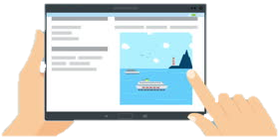
Social networking sites are a huge favourite when using the internet.
It allows you to:
  Stay in touch with friends over chat
  Meet new people with similar interests
  Share photos and videos
When used appropriately, social networks are a great place for you to demonstrate your creativity. As a online user, there’s plenty you can do to ensure your experience is both safe and fun.

Slide 30
The lower age limit for most social media networking sites is 13.
The most popular social networks include:
  Facebook | Twitter | Instagram | Youtube
  Tumblr | Ask.fm | Snapchat | Tik Tok
  Many sites include an instant message function which allows private conversations between site members. Users can also add friends to view their content. It is also possible to accept people that you don’t know.
  You can set privacy settings on most social networking sites so that only close friends can search for you, tag you in a photograph or share what you’ve posted.

Slide 31
Risks associated with Social Networking
Most social networking sites have apps, meaning you will have access on your smartphone or tablet. Some app versions of social networks use the location of your phone.
Facebook has a setting that allows you to approve or dismiss tags that people add to their posts. This is important as it gives the user some control in what they are tagged in.
Information shared between friends can be easily copied and may spread widely.
It isn’t easy to take back information that has been posted – and can be impossible if it’s already been shared.
Not everyone you meet online will be who they say they are. Chatrooms and forums can connect people who are complete strangers and the use can be unmoderated.
Chatrooms and forums are one of the places online groomers go to connect with children. There can also be places where people use a lot of sexual language and engage in online flirting. This is sometimes done through video chat programs such as Skype.

Slide 32

Activity
State 9 Tips you would give a friend to stay safe online.
With a partner, create a poster to highlight the importance of keeping your online presence safe.

Slide 33

Tips for Staying Safe Online
Educate yourself on what the various social networks and apps do.
Set up privacy settings at the strongest level.
Report people and inappropriate conversations to the site administrator via the ‘report’ tab and always keep a copy of the conversation as evidence.
Block/ignore people on social networking sites and online games that make you feel uncomfortable.
Never share any personal details including passwords, real names, address, and your school name.
Friends should be people you know – people you meet online may not be who they say they are. Never agree to meet someone you don’t know.
Know what you should and shouldn’t post online
Report directly to CEOP if someone is trying to meet up with your child or if you think your child is in immediate danger.
Know what you post can’t always be taken back, and even if it can, it may already have been shared. This applies to webcams too.

Slide 34
Using Apps
Some apps that allow children to create and maintain online relationships raise some important safety issues that it’s worth knowing about as an online user:
Safety Issue | Details
Chatting with strangers | Meeting and chatting with strangers online poses risks to grooming and online (and offline) forms and sexual abuse.
Sharing a location | Many apps share the user’s location. This can put children at risk from others who actively seek out children with the intention of meeting in the real world. Sharing a location can also raise concerns with identity theft and privacy.
Sending inappropriate content | With the physical barrier of a screen, some people feel more empowered to pressurise others into sending messages, often of offensive nature.

Slide 35
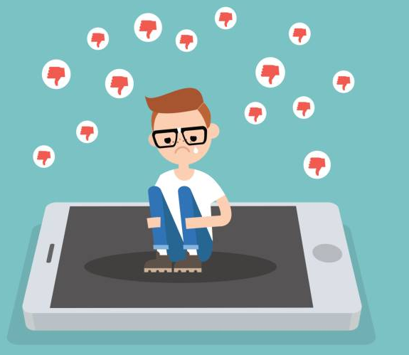
Cyberbullying
Cyberbullying is when someone bullies others using electronic devices, this might involve social media and messaging services on the internet, accessed on a mobile phone, tablet or gaming platform. The behaviour is usually repeated.
Like any form of bullying – cyberbullying can be horrible for people involved and can be hard for them to talk about.
Cyberbullying can consist of:
Threats and intimidation
Harassment and Stalking
Defamation
Rejection and Exclusion
Identity Theft – hacking into social media accounts and impersonation
Publically posting or sending on personal information about another person

Slide 36
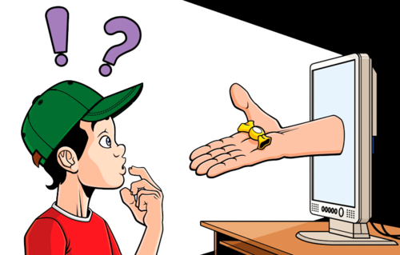
Online Grooming
It’s easy to pretend to be someone else on the internet, so children can sometimes end up having conversations with people whose real identities they may not know.
Groomers may go to a social network used by young people and pretend to be one of them. They might attempt to gain trust by using fake profile pictures, pretending to have similar interests, offering gifts and saying nice things.
Once they gain the child’s trust, the groomer often steers the conversation towards their sexual experiences, even asking them to send sexual photographs or videos of themselves. Some may try to set up a meeting, or even blackmail children by threatening to share the pictures or videos with the child’s family and friends.
Online groomers are not always strangers. In many situations they may already have met them through their family or social activities, and use the internet to build rapport with them. Sometimes children don’t realise they’ve been groomed, and think that the person is their boyfriend or girlfriend.

Slide 37
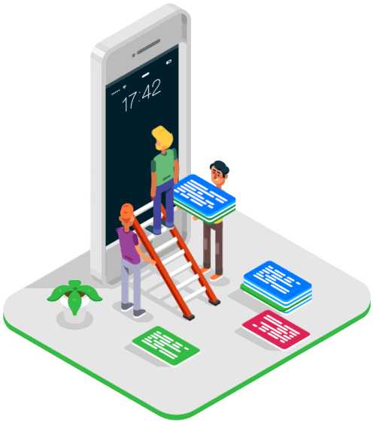
Inappropriate Content
What you think is inappropriate material will differ from others. It will also depend on your age and maturity level. Inappropriate content includes information or images that are upsetting, material that’s directed at adults, inaccurate information or information that might lead or tempt you into unlawful or dangerous behaviour.
This could be:
Pornographic material
Content containing swearing
Sites that encourage vandalism,, crime, terrorism, racism, eating disorders, even suicide
Pictures, videos or games which show images of violence or cruelty to other people or animals
Websites
Where there’s no one supervising the conversation and barring unsuitable comments

Slide 38
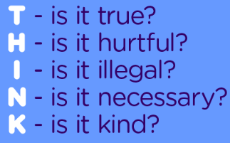
Digital Reputation
Your digital reputation is defined by your behaviours in the online environment and by the content you post about yourself and others.
Tagged photos, blog posts and social networking interactions will all shape how you are perceived by others online and offline, both now and in the future.
A poor digital reputation can affect your friendships, relationships and even your job prospects, so it is very important that you are aware of what picture you are painting yourself online and protect your digital reputation today.
Stop and THINK before you post online.

Slide 39


Feeling Uncomfortable? What to do
Do not delete any messages that you may receive as they may be used as evidence if it goes to court.
Do not reply to the messages
Tell an adult you trust – Parents, guardian, a teacher, grandparents etc.
Report it to CEOP or ChildLine

Slide 40

Worksheet: Glossary Terms
Complete the Online Safety Terms Worksheet.

Slide 41


Slide 42
Before you watch
The video you are about to watch tells a true story of a teenager who chats to a stranger over the internet using ‘Instant Messenger’.
Before you watch the video complete the ‘pre film questionnaire’ as honestly as possible.

Slide 43
Jenny’s Story (Resource 2)
Complete the worksheet “Pre Film Questionnaire” before watching this video.
Notes:
Resource 2 - Jenny's Story: https://www.youtube.com/watch?v=jXcd4bbzXUI

Slide 44

Class Discussion
After watching ‘Jenny’s Story’, has it changed your view about passing a stranger on to a friend on the internet?

Slide 45
Class Discussion
Has ‘Jenny’s Story’ increased your awareness of the dangers/risks of trusting someone that you have not met face to face online?

Slide 46
Class Discussion
Would you allow someone that you have met in a chatroom to contact you on your mobile phone, o your home phone, or by post?

Slide 47
Class Discussion
Would you meet up with someone you have only met on the internet on your own?

Slide 48
Class Discussion
If you were going to meet someone you have chatted to on the internet, would you tell someone?

Slide 49
Class Discussion
Do you know how to save conversations, where possible, that you have had in chatrooms/on instant messaging?

Slide 50
Class Discussion
If you were concerned about a person who contacted you on the internet who you didn’t know, would you tell anyone?

Slide 51
Class Discussion
Who would you tell?

Slide 52
Class Discussion
Would you send a photograph to someone you do not know via the internet?

Slide 53
Class Discussion
What do you think is the best piece of advice for young people about chatting to strangers on the internet?

Slide 54
Homework: Home Learning
Everybody should complete Task 1 to describe what you should do in each scenario.
Some of you may also want to get the extra marks by defining the key terms
Make sure you have written your homework clearly in your planner.

Slide 55

Your Digital Footprint
This is defined as “the trail or history left behind by all your interactions using the Internet, email, social media, texting, IM and even on demand TV. It can often be permanent.”
Activity: Write down the latest post, status or tweet you made via social media or website on a piece of paper.

Slide 56
Activity: Footprints in the sand.
Think about the latest post, tweet, photo, story you shared via a social network or website
How many online friends do you have. Multiply it by this number. All can see your post.
An average person has 500 friends. Multiple by 500 to represent all the “friends of friends” who may see your post.
Multiply by another 500 for all the “friends of friends of friends” who may see your post
You can quickly see how your digital footprint can spread.

Slide 57
Some Guidelines to Remember
Never post pictures online
Never post personal information online
Never post unacceptable comments online
Keep your profile private
Only accept real friends as your online friends
Use an avatar as your profile picture

Slide 58

Task: Desktop Publishing
Complete the Worksheet ‘Desktop Publishing Task’

Slide 59

Your Leaflet
First Draft

Slide 60
Recap of: Cyberbullying
“the use of social networks to repeatedly harm or harass other people in a deliberate manner”
Cyber bullying is often done anonymously so the victim does not know who the bully is.
Keeping evidence of any emails, posts and messages you receive, telling your parents/guardians/teachers and the Police will help you track down the bullies.
CE-OP have ways to use internet technology (IP Addresses) to trace the location the bullies.
Cyber bullying can very quickly escalate and other people become involved which means that the bullying can be done by many people rather than a small group of people.

Slide 61
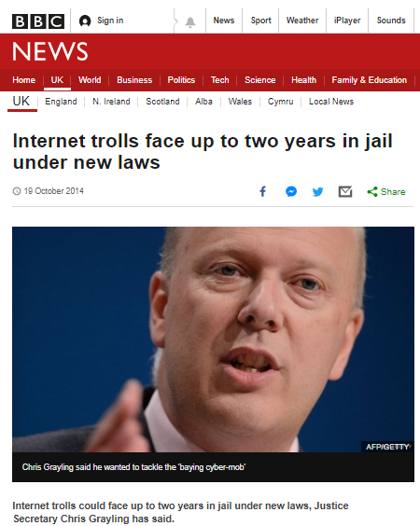
Recap of: Trolling
“a person who causes upset on the World Wide Web by starting arguments or upsetting people and by posting inflammatory comments.”

Slide 62
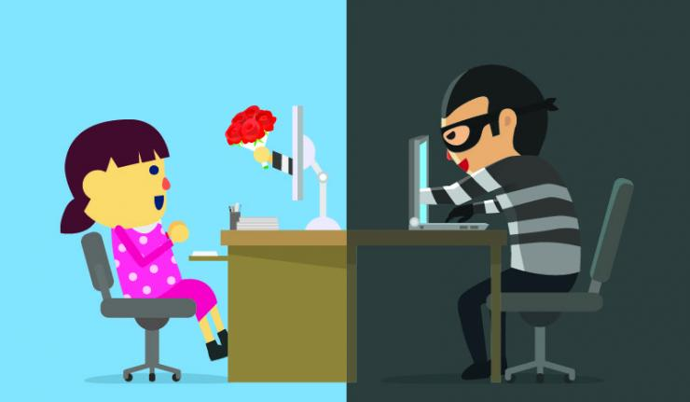
Recap of: Grooming
“Internet Grooming is the befriending and establishing an emotional connection with a child to lower the child's inhibitions for child sexual abuse.”

Slide 63
Assessed Group Project: E Safety Video
COMMUNICATION
TEAM PLAYER
ORGANISED
CREATIVE
INFORMATIVE
Discuss in pairs what these words mean. How will they affect:
How you work
How the words can be applied to you
Do you know how to be all of the above?

Slide 64

Team Video Project
You are each going to be split into groups of 3 by your teacher.
Give yourself a Team Name. Create a folder inside your Documents with this team name as the name of the folder.

Slide 65
Team Video Project
You will have 3 lessons to plan, design, create and edit a video lasting no longer than 2 minutes to promote:
STAYING SAFE ONLINE

Slide 66
Team Video Project
Task This Lesson: Agreeing Roles
There are a total of 5 roles in this project which you need to split into fair amounts:
  Researcher (Person 1)
  Designer (Person 2)
  Creator (Person 3)
  Editor (Person 1 or 3)
  Organiser (Person 1/2/3)

Slide 67
Team Video Project
Complete the Team Video Worksheet to explain who is doing what.
SAVE this document into your Team Folder. Everyone in the group needs to make their own copy!

Slide 68

This Week: ORGANISING IT ALL
We have already been Wizard’s and have learnt about how to organise our files and folders – now it’s time to prove it!
EVERYONE should create a folder called E SAFETY within their Year 8 ICT folder.
Within this folder, we need to create a few subfolders:
  Images
  Video Assets
  Audio
We need to ensure EVERYTHING has a meaningful name.
I do not want to see your e safety images saved in ‘My Pictures’

Slide 69

Teamwork!
Working together, it is important you spend your time wisely!
Remember you need to get lots of images that are suitable and illustrate exactly what you want it to say!
Your teacher will be conducting project meetings today with each team. This will include where your group is in terms of progress, and what you hope to achieve this lesson.
Your teacher will possibly also offer assistance you may need to make your desired progress.

Slide 70

Check List for Today
Obtain/create some resources for your E-Safety video and save them, with an appropriate name, into a suitable place in your area (Year 8 > ICT > E Safety).
Decide who is doing what for Home Learning ready for next lesson.
  Do you need to design a script at home?
  Do you need to record a video clip? If so, you need to organise how you are going to do this. Remember you need to put this onto a USB or store in Google Drive so you can access it in school!
  Do you need to get a sound clip/music from home?

Slide 71
How to download YouTube Clips at HOME
You can only download videos and music at home.
VIDEOS
To download videos, you can use:
www.clipconvertor.cc
AUDIO
To download Sounds, you can use:
https://www.vidtomp3.com/
You may need to put a link in your video to the owner to avoid breaking Copyright Laws!

Slide 72

Spend the rest of this lesson grabbing those images!

Slide 73
LESSON TASK: Collecting Image Assets
Remember your roles!
For this lesson, let’s get ALL image assets stored and sorted.
One person should be collecting and storing images
One person should be creating the MovieMaker Or Canva Project
One person should be designing the Project/Storyboarding

Slide 74

Homework: Continuing the Work
Before you leave, decide in your group who needs to do what in preparation for next lesson.
Make a note of the agreement in your homework diary.

Slide 75
In your groups discuss that these words mean. And what effect they could have on your work this lesson.
TRANSITION INFORMATION
AUDIO EFFECT TESTING
TIMING SPELLING CLARITY
How will you include these and ensure these are in your presentations? Who will be in charge of ensuring these are included?

Slide 76
Project Meetings
Your teacher will be coming round to each group today to check on your progress
We will look at your Video Progress
What you hope to achieve today
Who will be doing what in your group
What assistance you may need to make your desired progress

Slide 77
Check List for Today
Team Roles – who is doing what in your team
A Completed Video with audio, effects, transitions
Export your completed video in a suitable file format such as WMV
You will presenting your video to the class next week. Create some notes to assist your video screening
What can you do for Home Learning ready for next lesson.

Slide 78
HOMEWORK: SUBMISSION
In your groups, you need to complete your video presentation for next lesson. That includes exporting the video and uploading this submission.
Make sure you include all names of people in your group in the file name! i.e.
ONLINE SAFETY VIDEO – BY MR BUTLER.mp4
You should not be submitting the project file!

Slide 79

LAST CALLS: ENSURE YOUR VIDEO IS UPLOADED

Slide 80

VIDEO RATINGS!!!
Open the Video Ratings Worksheet
You will need to create an entry for each group.
We will watch the videos together and we will be looking for:
  Two great things about the video
  One Possible Improvement
  Does it get the aim of highlighting Online safety across?
  Overall rating (out of 10)

Slide 81
The First Group up is…

Slide 82
Now we have watched and rated everyone’s video, we need to look at Feedback and Evaluation
You have 5 minutes to discuss in pairs the following question:
Q. Why is Feedback and Evaluation so important?

Slide 83
The Importance of Feedback and Evaluation
Lets you judge what progress you have made.
What your strengths and areas for development are
What you have learnt and what you could apply to future work
What improvements could you make on future projects

Slide 84
Teacher Feedback
You will have received verbal feedback from your teacher on your E-Safety Video project.
Now it time to reflect on your work and evaluate what improvements you could make.
Self assess your video then get together as a group to discuss the different improvements you could make.

Slide 85

Self and Group Evaluation
Features to Evaluate
Do all the images/audio/ work as expected ?
Consistent message given?
Consistent look and feel ?
Consistent effects and transitions?
Good narration?

Slide 86
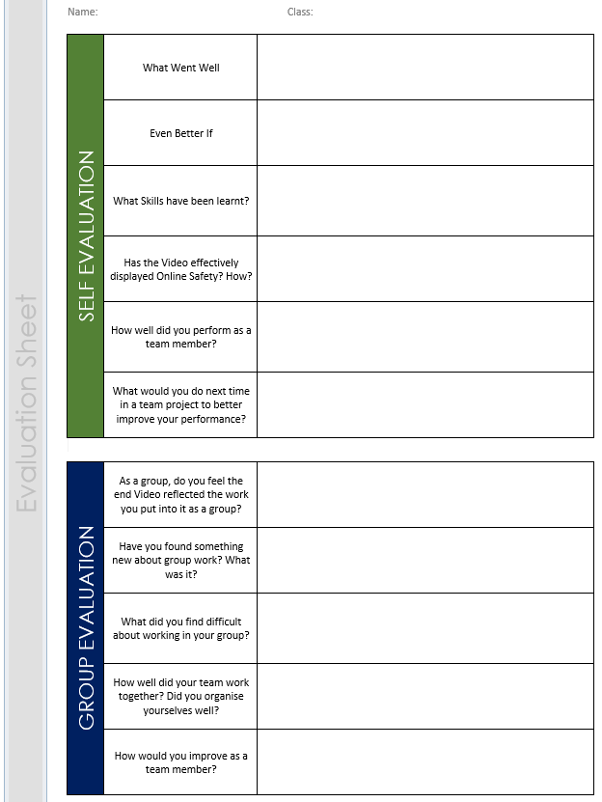
The Evaluation Task
You will be completing an Evaluation task today.
You will need to take on board all the verbal comments made:
  After the class viewed you video
  Comments made by your teacher
  Your groups own comments
  Your personal view of your video
Complete the Evaluation Sheet before next lesson.

Slide 87

Improvements!
Spend this lesson working in your groups to implement improvements to your Video.
Which improvements are most realistic and easiest to do?
You can extend this work in Computer Club if you need more time and/or you want to improve your video editing skills.

Slide 88

Recap of Today’s Lesson
Today you have:
All have evaluated their feedback and listed changes they will make to your E-Safety Video.
Most have described the impact the improvements could have
Some have evaluated their feedback and justified improvements that would make their video more professional

